Slide 1

Project - Library
Laura Glode - 2TPIFI1

Slide 2
Introduction
Purpose: To design a modern, user-friendly Library Management System that enhances the member experience and streamlines operations.
01
Problem: The current manual system is outdated, leading to inefficiencies, errors, and delays.
02
Solution: A digital platform that tracks books, members, borrowing, purchases, and preferences in real time.
03
Goal: To simplify operations, reduce mistakes, provide personalized service.
04

Slide 3
Business and Mission
Track: Manage books, members, borrowing, purchases, and preferences efficiently.
Improvement: Replace outdated data handling with a real-time, updateable database.
Service: Allow members to view their history and receive tailored recommendations.

Slide 4
Business Rules
History Access: Members can view their borrowing and purchase records.
Borrowing: A book can be borrowed if available; otherwise, members can reserve it and get notified when it’s ready.
Ordering: Members can order books with a 50% deposit and are notified upon arrival.
Librarian Role: Librarians manage all records—adding members, updating book status, and handling transactions.

Slide 5
Assumptions
Data Privacy: Members agree that their borrowing history and reading preferences can be accessed by librarians to improve service.
01
Book Orders: Members can order books not currently in the library and will be notified once the books arrive.
02
Book Reservations: Members can reserve unavailable books and will be notified when they become available.
03

Slide 6
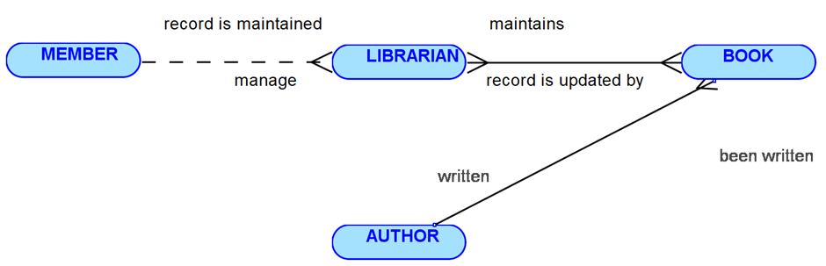
Conceptual model (MCD)

Slide 7
Entity Relationship Diagram (MLD)
Sentences for each relationship, in both directions
Each Preference may belong to one and only one member. Each Member may enter one or more Preference.
Each Member may can request one or more Reservation. Each Reservation must be made by one and only one Member.
Each Member may buy one or more Purchase. Each Purchase must be record by one and only one Member.
Each Member may place one or more Book Order. Each Book Order must be placed by one and only one Member.
Each Member may have it's record maintained by one or more Librarian. Each Librarian may manage by one and only one Member.
Each Member may create one or more borrowing. Each borrowing must belong to one and only one Member.

Slide 8
Entity Relationship Diagram (MLD)
Sentences for each relationship, in both directions
Each Book may can have one or more Reservation. Each Reservation must be recorded by one and only one Book.
Each Book may can be purchased by one or more Purchase. Each Purchase must be recorded by one and only one Book.
Each Book may can be ordered by one or more Book Order. Each Book Order must be for one and only one Book.
Each Book may can have it's record updated by one or more borrowing. Each borrowing must be recorded for one and only one Book.
Each Book must have it's record updated by one or more Librarian. Each Librarian must maintain one or more Book.
Each Book must be written by one or more Author. Each Author must write one or more Book.

Slide 9
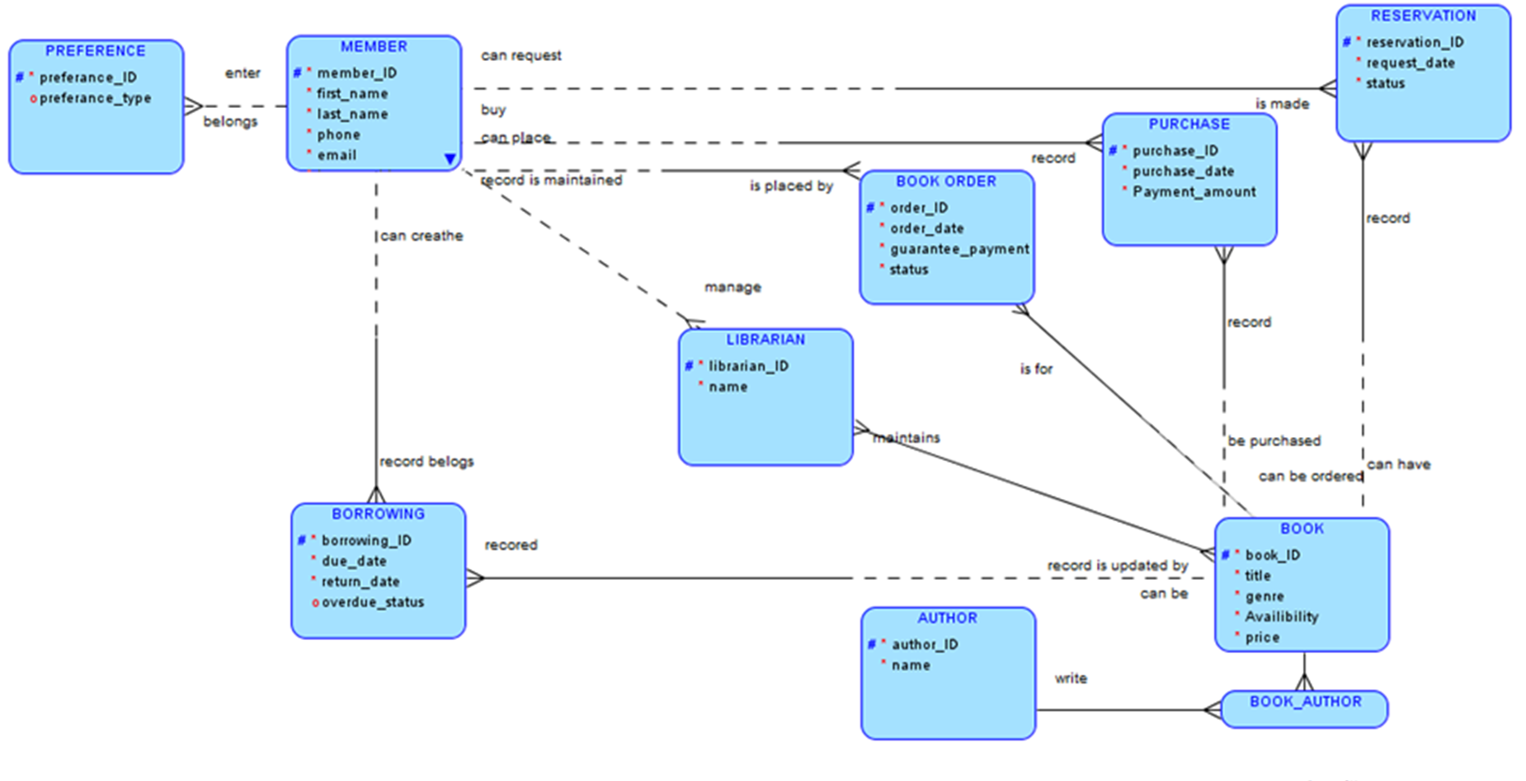
Entity Relationship Diagram (MLD)
Map the relationships.

Slide 10
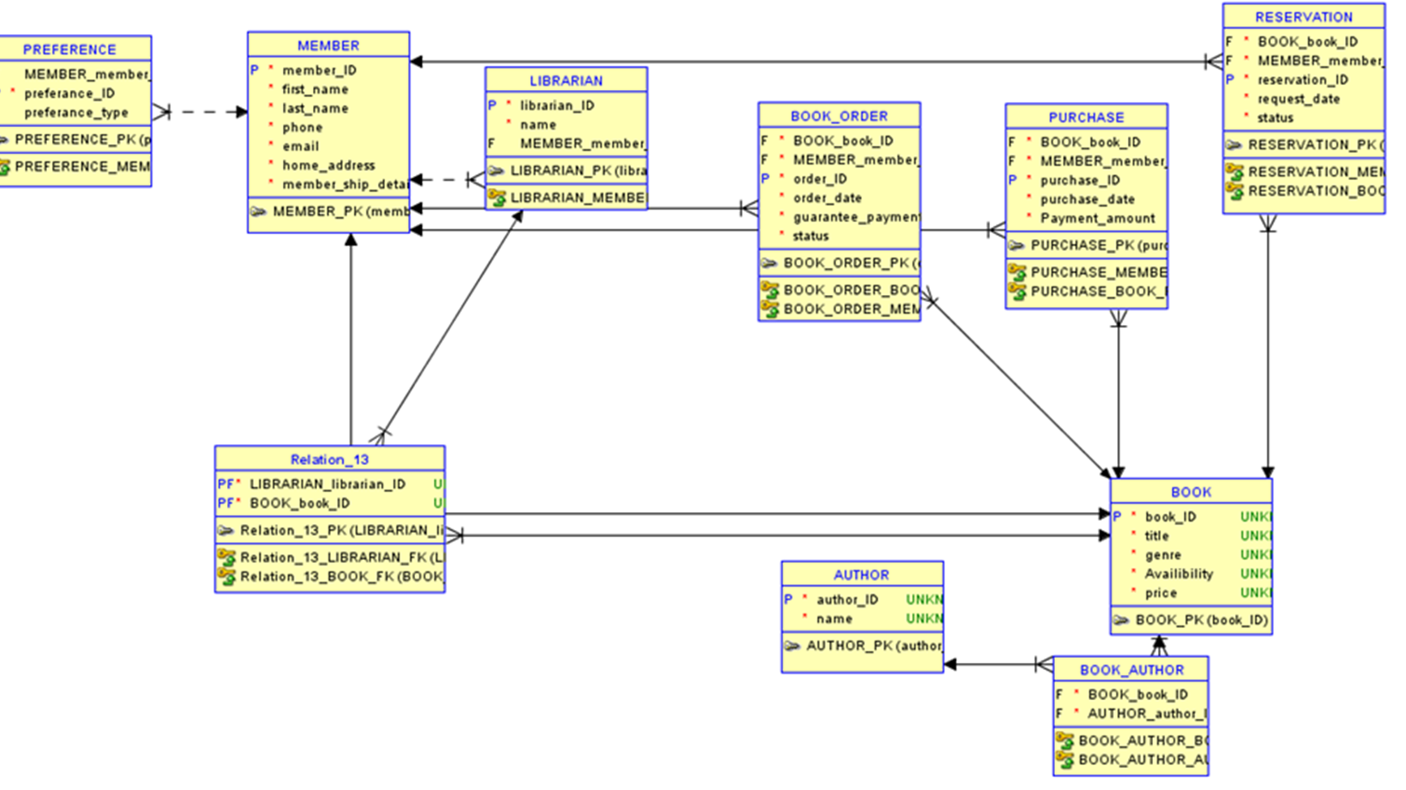
Entity Relationship Diagram (MLD)
Map the relationships.

Slide 11
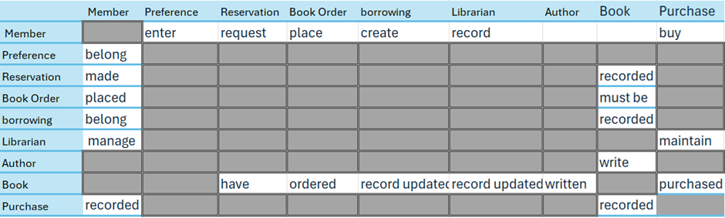
Entity Relationship Diagram (MLD)
Draw the matrix diagram

Slide 12
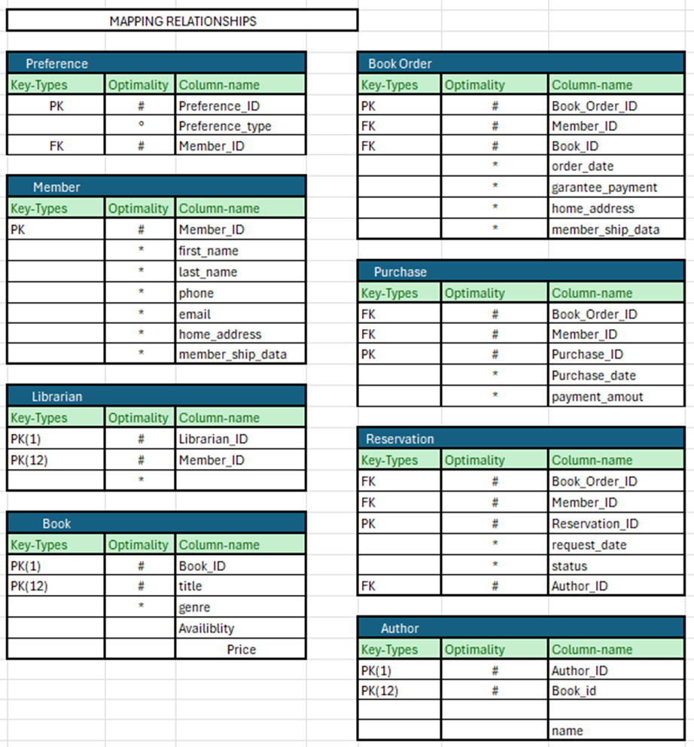
Entity Relationship Diagram (MLD)
Draw the matrix diagram

Slide 13
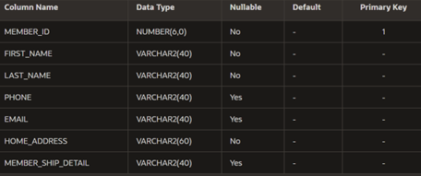
Tables:
CREATE TABLE Library_Member(
member_ID number(6) CONSTRAINT lib_mem_id_pk PRIMARY KEY,
first_name varchar2(40) NOT NULL,
last_name varchar2(40) NOT NULL,
phone varchar2(40),
email varchar2(40),
home_address varchar2(60) NOT NULL,
member_ship_detail varchar2(40),
CONSTRAINT lib_phone_email_uk UNIQUE (phone, email)
);

Slide 14
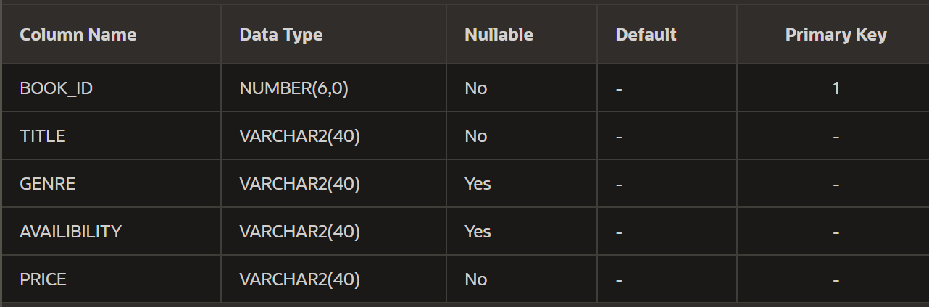
Tables:
CREATE TABLE Library_Book(
book_ID number(6) CONSTRAINT lib_book_id_pk PRIMARY KEY,
title varchar2(40) NOT NULL,
genre varchar2(40),
availibility varchar2(40),
price varchar2(40) NOT NULL
);

Slide 15
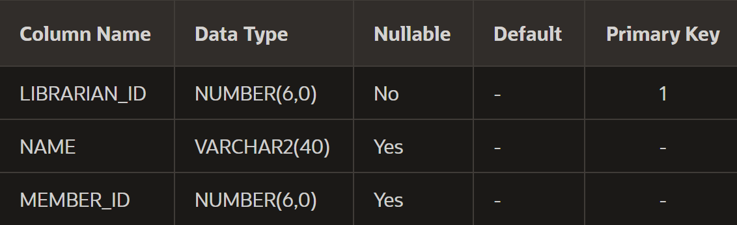
Tables:
CREATE TABLE Library_Librarian(
librarian_ID number(6) CONSTRAINT lib_lib_id_pk PRIMARY KEY,
name varchar2(40),
member_ID number(6),
CONSTRAINT lib_mem_id_fk FOREIGN KEY (member_ID) REFERENCES Library_Member(member_ID)
);

Slide 16
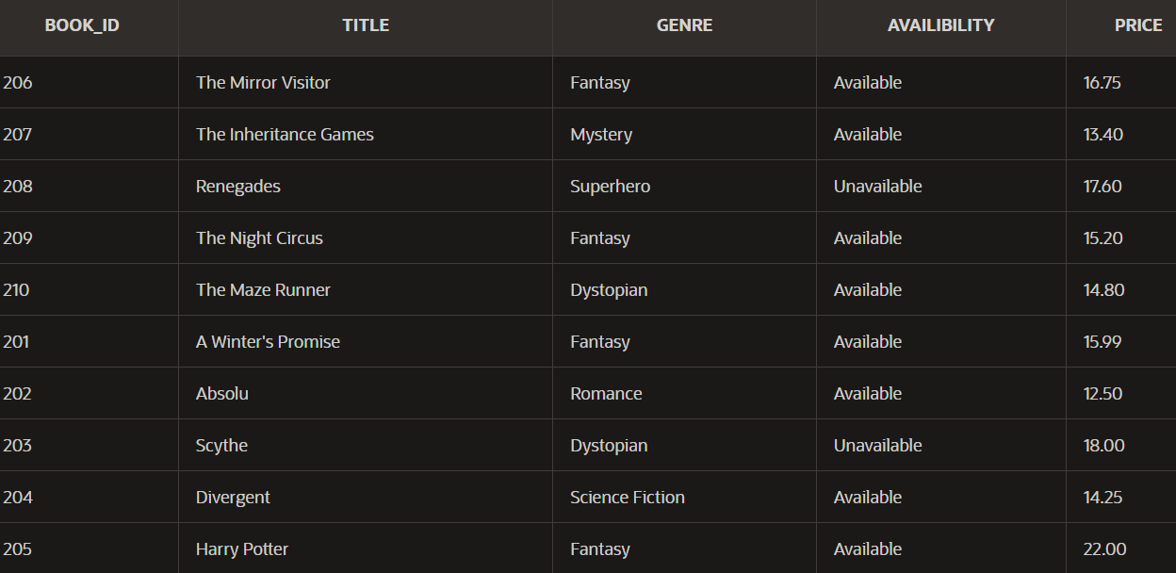
Data Tables:
insert all into Library_Book
values (201, 'A Winter''s Promise', 'Fantasy', 'Available', '15.99')
INTO Library_Book VALUES (202, 'Absolu', 'Romance', 'Available', '12.50')
INTO Library_Book VALUES (203, 'Scythe', 'Dystopian', 'Unavailable', '18.00')
INTO Library_Book VALUES (204, 'Divergent', 'Science Fiction', 'Available', '14.25')
INTO Library_Book VALUES (205, 'Harry Potter', 'Fantasy', 'Available', '22.00')
INTO Library_Book VALUES (206, 'The Mirror Visitor', 'Fantasy', 'Available', '16.75')
INTO Library_Book VALUES (207, 'The Inheritance Games', 'Mystery', 'Available', '13.40')
INTO Library_Book VALUES (208, 'Renegades', 'Superhero', 'Unavailable', '17.60')
INTO Library_Book VALUES (209, 'The Night Circus', 'Fantasy', 'Available', '15.20')
INTO Library_Book VALUES (210, 'The Maze Runner', 'Dystopian', 'Available', '14.80')
select 1 from dual

Slide 17
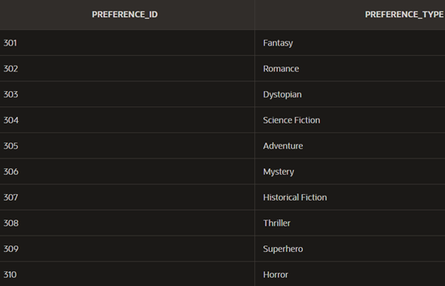
Data Tables:
insert all into Library_Preference
values (301, 'Fantasy')
INTO Library_Preference VALUES (302, 'Romance')
INTO Library_Preference VALUES (303, 'Dystopian')
INTO Library_Preference VALUES (304, 'Science Fiction')
INTO Library_Preference VALUES (305, 'Adventure')
INTO Library_Preference VALUES (306, 'Mystery')
INTO Library_Preference VALUES (307, 'Historical Fiction')
INTO Library_Preference VALUES (308, 'Thriller')
INTO Library_Preference VALUES (309, 'Superhero')
INTO Library_Preference VALUES (310, 'Horror')
select 1 from dual;

Slide 18
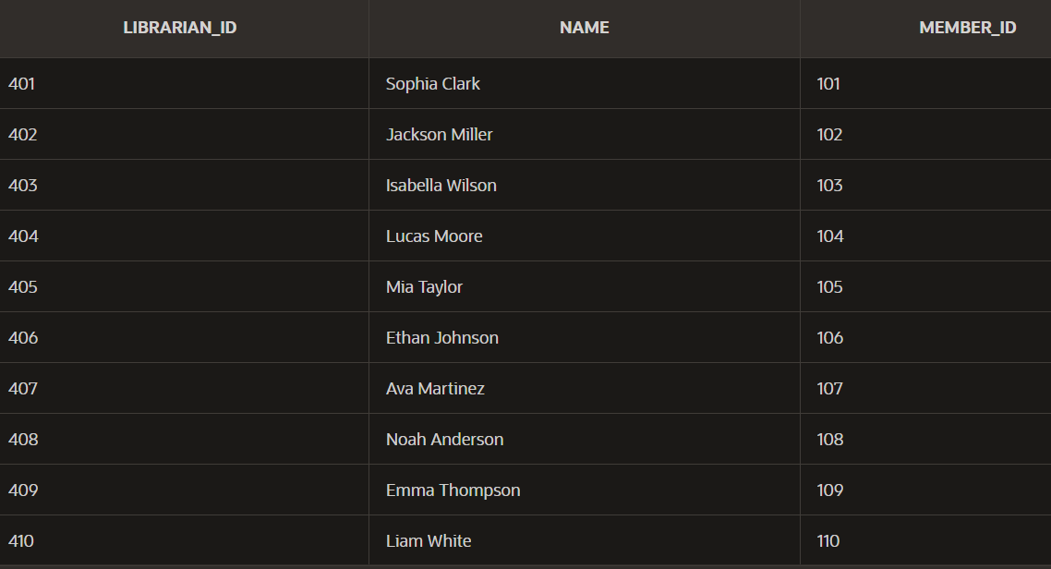
Data Tables:
insert all into Library_Librarian
values (401, 'Sophia Clark', 101)
INTO Library_Librarian VALUES (402, 'Jackson Miller', 102)
INTO Library_Librarian VALUES (403, 'Isabella Wilson', 103)
INTO Library_Librarian VALUES (404, 'Lucas Moore', 104)
INTO Library_Librarian VALUES (405, 'Mia Taylor', 105)
INTO Library_Librarian VALUES (406, 'Ethan Johnson', 106)
INTO Library_Librarian VALUES (407, 'Ava Martinez', 107)
INTO Library_Librarian VALUES (408, 'Noah Anderson', 108)
INTO Library_Librarian VALUES (409, 'Emma Thompson', 109)
INTO Library_Librarian VALUES (410, 'Liam White', 110)
select 1 from dual;

Slide 19
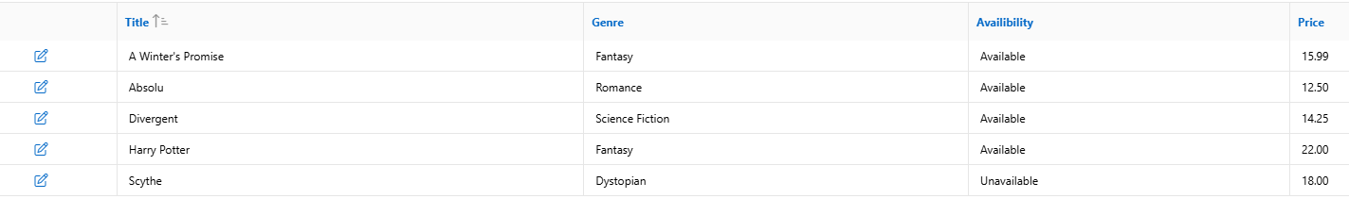
Library_Book
Form
Purpose: Used to add or edit book details. Description: This form ensures accurate data entry for each book, including fields like title, genre, availability, and price.

Slide 20
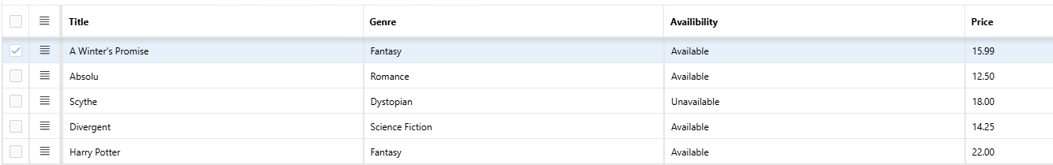
Library Member
Interactive grid:
Purpose: Manage multiple book records at once. Description: A spreadsheet-style view that allows inline editing, sorting, and filtering—ideal for quick updates.

Slide 21
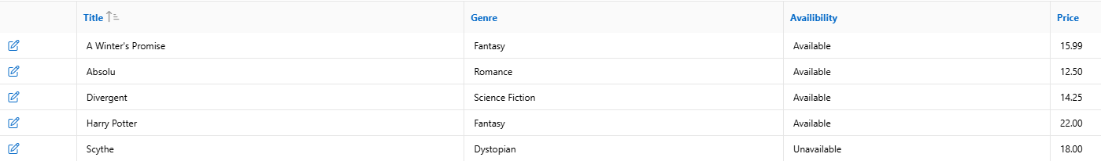
Library Member
Interactive report:
Purpose: View and analyze book data. Description: A dynamic report that displays book records with filtering options—great for tracking availability or generating insights.

Slide 22

Thanks for listening!
Any questions?

